Slide 1

Session 3: Mastering Layouts & OOP
Building Professional, Reusable, and Scalable Flutter Apps for Enactus.

Slide 2
Part 1: OOP & Constructors
The Blueprint of Reusable Components

Slide 3

Dart Constructors & "this" Keyword
Dart simplifies data injection into widgets using short-form constructors. This is essential for creating components that display different data.
class
final
const
super
required this
Short-form: Use this.variable to assign values instantly.
Required: Force data passing with the required keyword.
Key: The super.key helps Flutter track widget identity.

Slide 4
Part 2: Advanced Layouts
Row, Column, Stack, and Flex Space

Slide 5

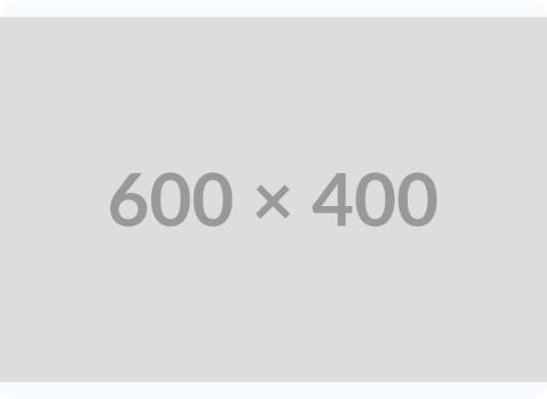
Row & Column: Alignment Mastery
MainAxisAlignment: Controls spacing along the primary axis (Horizontal for Rows).
CrossAxisAlignment: Controls alignment perpendicular to the primary axis.
Expanded Widget: Forces a child to fill the remaining available space.

Slide 6

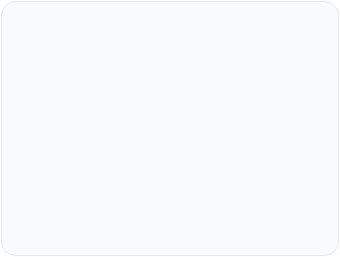
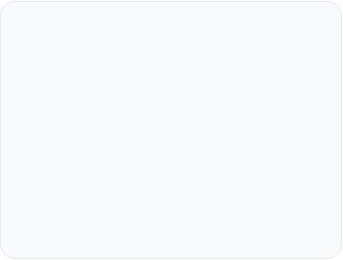



The Stack: Layers & Z-Axis
Overlap Elements
Positioned Widget
Common Use Case
Place widgets on top of each other. The first child in the list is at the bottom of the stack.
Use Positioned to place children at specific coordinates (top, bottom, left, right) within a Stack.
Perfect for adding badges to icons, text over images, or custom decorative background shapes.

Slide 7
Part 3: Reusability & Files
Clean Code & Refactoring

Slide 8

Modular Folder Structure
Scalability
As your Enactus project grows, keeping all widgets in main.dart becomes impossible to manage.
By moving widgets to lib/widgets/ and screens to lib/screens/, you achieve true modularity and code reuse across different parts of the app.

Slide 9
Why Refactor into Classes?
DRY Principle: Don't Repeat Yourself. Change once, update everywhere.
70%
Performance: Class-based widgets allow for const constructors, saving CPU cycles.
Collaboration: Team members can work on different files simultaneously without merge conflicts.
Reduction in Code Duplication

Slide 10
Choosing Your Constructor Type
Feature | Positional | Named (Recommended)
Ordering | Strict Order Required | Any Order
Readability | Poor (Values only) | Excellent (Key: Value)
Optionality | Difficult to skip | Very easy to omit

Slide 11
" Great software design is not about building everything at once; it's about building small, reliable pieces that fit together. "

Slide 12
Questions?
Ready to build the Enactus Member Directory?
Next Session: Dynamic Lists & Data Modeling

